Slide 1

Group Project
Environmental Monitoring using IoT
Group Members:
Brintha Shree. S. S
Kalpana Chawla. M
Kavipriya. P
Yogalakshmi. S

Slide 2

Introduction
IoT stands for "Internet of Things." It refers to the network of physical objects or "things" embedded with sensors, software, and other technologies that enable them to connect and exchange data with other devices and systems over the internet or other communication networks.

Slide 3
OBJECTIVES
Enhance Visitor Safety and Security
Enhance visitor engagement
Visitor Satisfaction and Feedback
Consolidated Park Operations
Promote sustainability by monitoring and reducing the park's environmental footprint, such as reducing water usage, waste generation, and carbon emissions.
Data-Driven Decision-Making
Emergency Response Planning
Maintenance and Repairs

Slide 4

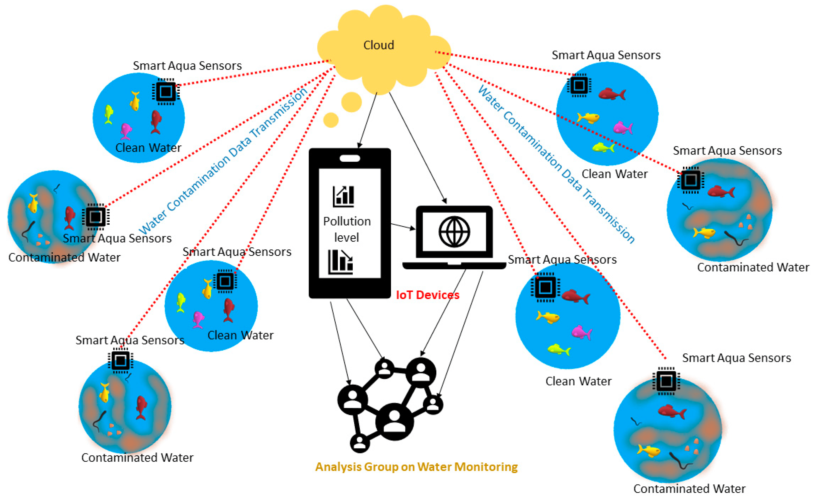
IoT in Environmental Monitoring
The applications of IoT in environmental monitoring are broad − environmental protection, extreme weather monitoring, water safety, endangered species protection, commercial farming, and more. In these applications, sensors detect and measure every type of environmental change.

Slide 5

Sensors used in our Project
Motion Sensors:
Motion detectors, such as passive infrared (PIR) sensors or ultrasonic sensors, can detect the presence and movement of visitors within a specific area. These sensors are often used for security and automation purposes.
Proximity Sensors:
Proximity sensors, including infrared sensors and RFID (Radio-Frequency Identification) tags, can track visitors as they enter or exit a defined area. RFID tags can be attached to visitor badges or products for tracking purposes.
GPS Tracking:
In outdoor environments, GPS technology can be used to track the movements of visitors. This is often employed in applications like tour tracking or monitoring crowd density at large events.
Audio Sensors:
Audio sensors or microphones can capture sounds and conversations in an area. They may be used for security purposes or to analyze customer interactions in a retail or hospitality setting.
Environmental Sensors:
Environmental sensors can measure factors like temperature, humidity, and air quality. Monitoring these parameters can be useful for ensuring visitor comfort and safety.
Counters and People-Counting Sensors:
These sensors, often utilizing infrared or laser technology, count the number of people entering or exiting a location. They are frequently used in retail stores and museums to monitor visitor traffic.

Slide 6
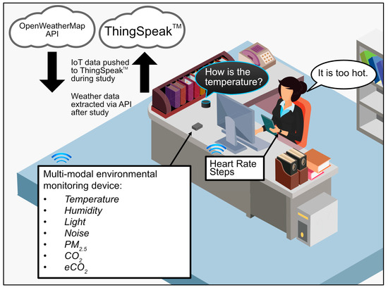
Environmental Monitoring Platform
ThingSpeak is commonly used as an environmental monitoring platform. ThingSpeak is an open-source Internet of Things (IoT) platform developed by MathWorks, which is primarily designed for collecting, analyzing, and visualizing data from various IoT sensors and devices. It provides an accessible and user-friendly way to build IoT applications and gather data from sensors, making it suitable for a wide range of applications, including environmental monitoring.

Slide 7
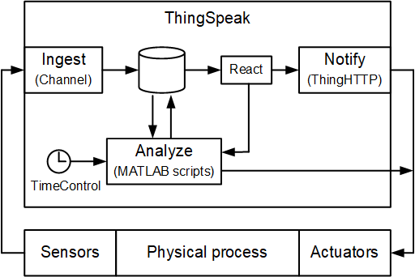
INTEGRATION APPROACH
HTTP(S): ThingSpeak provides a straightforward HTTP(S) API that allows devices to send data using simple HTTP POST requests. This is a common method for IoT devices with internet connectivity.
Generate API Keys: To send data to ThingSpeak, you'll need to create a ThingSpeak account and generate API keys. These keys are used to authenticate your IoT device when it sends data to ThingSpeak. You can create and manage API keys in your ThingSpeak account settings.
Configure IoT Device:
Set Up Network Connectivity: Ensure that your IoT device is connected to the internet or a local network with internet access.
Install Necessary Libraries/SDKs: Depending on your device's programming language and platform, you may need to install libraries or SDKs that enable communication with ThingSpeak.
Provide API Key: Incorporate the generated API key into your device's code or configuration settings. This key is crucial for authentication when sending data to ThingSpeak.

Slide 8
Conti….
Collect and Format Data: Prepare the data you want to send to ThingSpeak in the appropriate format. ThingSpeak expects data to be structured in fields within a channel. Each field can represent a different type of data (e.g., temperature, humidity, pressure).
Send Data to ThingSpeak:
HTTP(S) POST Request: Devices can send data to ThingSpeak by making HTTP POST requests to the ThingSpeak API endpoint. Include the API key and the data in the request body as key-value pairs.
Handling Responses: IoT devices should handle responses from ThingSpeak to confirm whether the data was successfully received. ThingSpeak typically responds with status codes or acknowledgments that indicate the success or failure of the data transmission.
Error Handling and Retry Mechanisms: Implement error handling and retry mechanisms in your device's code to handle situations where the data transmission fails due to network issues or other factors.
Security: Ensure that your data transmission is secure, especially if you are sending sensitive data. Use HTTPS for secure communication, and protect your API keys.
Testing and Monitoring: Before deploying your IoT devices for data transmission, thoroughly test the communication process to verify that data is being sent and received correctly. Monitor the data in your ThingSpeak channel to confirm that it reflects the expected information.

Slide 9
MY ROLE
Project Leader:
Define project objectives, scope, and milestones.
Develop a project plan and timeline.
Allocate resources and budget.
Coordinate communication among team members and stakeholders.
Monitor progress and ensure that the project stays on track.
Address any issues or obstacles that arise during the project.
Ensure compliance with relevant regulations and standards.
Data Analyst:
Define data collection requirements and data formats.
Develop data collection and storage strategies.
Create data pipelines to ingest and process data.
Analyze collected data for trends, anomalies, and insights.
Generate reports and visualizations to communicate findings.
Implement data quality control and validation procedures.
Continuously refine data analysis techniques.

Slide 10
THANK YOU!

